Slide 1
Cloud Service Models
IBM Cloud Ecosystem Development

Slide 2
Objective
After completing this module you will be able to:
  a. Describe Cloud service models and IBM Cloud offerings
    1. IBM SoftLayer Infrastructure as a Service (IaaS)
    2. IBM Bluemix Platform as a Service (PaaS)
    3. Software as a Service (SaaS) and IBM Cloud Marketplace
  b. Describe the different capabilities of IBM Bluemix
    1. IBM Bluemix PaaS provided by Cloud Foundry
    2. IBM Bluemix Containers using docker
    3. IBM Bluemix virtual machines powered by OpenStack
Notes:
Cloud is not only the term of technology but also is a business offering model.
As we know, Infrastructure as a Service (IaaS), Platform as a Service (PaaS) and Software as a Service (SaaS) are three Cloud service models.
In this section, we will describe the benefits of each Cloud service models and IBM Cloud offerings related to the service models. Then we will introduce the different capabilities of IBM Bluemix for developers to make best decision on hosting their applications on the Cloud.

Slide 3

Cloud Service Models
and
IBM Cloud Offerings
Notes:
As we know, Infrastructure as a Service (IaaS), Platform as a Service (PaaS) and Software as a Service (SaaS) are three Cloud service models. In this session, we will describe the benefits of each Cloud service models and IBM Cloud offerings related to the service models.

Slide 4
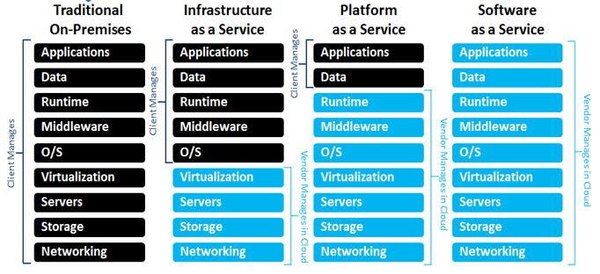
Cloud Services Models and IBM Cloud Offerings
Customization; higher cost; slower time to value
Standardization; lower cost; faster time to value
Notes:
Timing is critical if your apps (and the functionality they provide to your employees and/or customers) are to keep up with the new expectations and competition the app revolution has generated. This slide summarizes the components of each Cloud service model. The components in black are managed by clients, the service providers manage the components in blue for clients in cloud environment. Client has more control and higher customization on the left hand side of traditional on-pre model, has higher standardization and faster time to market on the right hand side of the SaaS model.

Slide 5
Traditional On-Premises – Core IT
Client Manages
Core IT
Code
Benefits
Fully customizable.
Few limitations.
Necessary for some solutions.
Existing Investments.
Data
Runtime
Middleware
Time Commitment
Weeks to setup and deploy.
Maintenance/upgrades of hardware and software.
OS
Virtualization
Servers
Storage
Networking
Time to initial deployment
~ Weeks
~ Days
~ Minutes
Notes:
Core IT represents everything you own and manage in your data centers (the full stack pictured here). This is still a critical part of enterprise IT - let’s take a look why it is beneficial and what it takes to manage all of this.
Traditional On-Premise Benefits -
As stable and customizable as the customer wants - the only main limitation is cost.
Necessary for certain solutions (Core IT still has value in many scenarios i.e. transaction processing)
Houses a lot of the investments most companies have already made (customer data, inventory, SAP, you name it).
Traditional On-Premise Time Commitment -
Typically takes weeks to setup an environment and deploy an initial app - customer manages entire stack pictured here
Have to maintain hardware and software as well (think environment uptime, fixes, and upgrades). Dedicated staff necessary.
Thus, Core IT doesn’t lend itself to the experimental nature of development in the cloud/app revolution
Core IT represents everything you own and manage in your data centers (the full stack pictured here). This is still a critical part of enterprise IT - let’s take a look why it is beneficial and what it takes to manage all of this.
Core IT Benefits
As stable and customizable as the customer wants - the only main limitation is cost.
Necessary for certain solutions (Core IT still has value in many scenarios i.e. transaction processing)
Houses a lot of the investments most companies have already made (customer data, inventory, SAP, you name it).
Core IT Time Commitment
Typically takes weeks to setup an environment and deploy an initial app - customer manages entire stack pictured here
Have to maintain hardware and software as well (think environment uptime, fixes, upgrades). Dedicated staff necessary.
Thus, Core IT doesn’t lend itself to the experimental nature of development in the cloud/app revolution

Slide 6

Infrastructure as a Services (IaaS)
Client Manages
Vendor Manages in Cloud
Infrastructure as a Service
Code
Benefits
Most control in the cloud.
Necessary for some solutions.
Infrastructure managed by SP.
Data
Runtime
Middleware
Time Commitment
Minutes to provision VM.
Time to configure software and apps varies.
Maintenance/upgrades of OS, middleware, runtime.
OS
Virtualization
Servers
Storage
Networking
Core IT
Time to initial deployment
~ Weeks
~ Days
~ Minutes
Notes:
Infrastructure as a Service (and specifically IBM’s acquisition of SoftLayer) was the cloud’s initial answer to the need for faster deployments, faster environment setup, etc… by abstracting the infrastructure from the customer. It manages infrastructure resources in a resource pool, with self-service provisioning, rapid elasticity, and as measured services. Virtualization alone does not accomplish this vision and set of characteristics. After all infrastructure resources are provided and managed as a set of capacity services, the data center can be treated as a true software-defined environment
IaaS Benefits
Networking, Storage, Server, Vitualization managed by service provider.
Most customizable cloud offering
Solutions where` customizability of OS, Middleware, or Runtime needed
IaaS Time Commitment
Customer sets up and manages OS, Middleware, and Runtime - these still take at least a matter of days to setup and reach an initial deployment
Maintenance/upgrades necessary as well

Slide 7
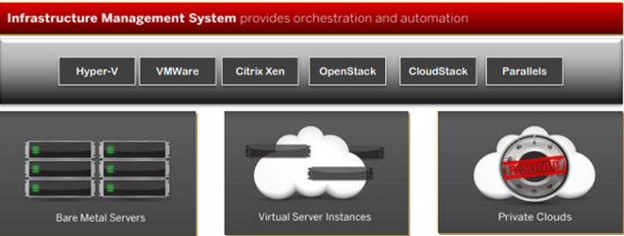
IBM SoftLayer IaaS Offerings
Highly flexible architecture
One platform for public cloud servers, private clouds, bare metal servers
Unified systems management & API
Technology-neutral platform
Support for broad range of operating systems, virtualization platforms
Notes:
SoftLayer is IBM’s BlueMix IaaS . SoftLayer provides:
Highly flexible architecture
One platform for public cloud servers, private clouds, bare metal servers
Unified systems management & API
Technology-neutral platform
Support for broad range of operating systems, virtualization platforms
Key Resources it offers including:
A dedicated bare metal server, custom configured to your spec: Wide selection, from low range to GPU, etc. You can install anything you want and use it as a building block
A Virtual Machine (VM, Cloud Computing Instance or CCI)
Off server Storage Options: NAS, SAN, Object storage
A private or hybrid cloud
Hardware Firewalls and Load Balancers
IP addresses, subnets, VLANs
Services: Backups, Vulnerability scans, Object Store, Monitoring, Messaging service, Content Delivery Network (CDN), Email delivery service, Anti-virus software, DNS entries

Slide 8

Platform as a Services (PaaS)
Client Manages
Platform as a Service
Vendor Manages in Cloud
Benefits
Setup environments and deploy apps very quickly.
Infrastructure and platform managed by Service Provider.
Code
Data
Runtime
Middleware
OS
Time Commitment
Minutes to setup and deploy.
Focus on your apps and their data.
Virtualization
Servers
Storage
Networking
IBM Bluemix PaaS Environment based on Cloud Foundry
Core IT
IaaS
Time to initial deployment
~ Weeks
~ Days
~ Minutes
Notes:
The concept of composable solutions in a Cloud Environment, which consists of finer grained services that can be recombined to create new capabilities, is a key element of the cloud. Composable environments can contain cloud services, which bring together operational, development, application, database, and third-party services – all with embedded monitoring and manageability capabilities.
PaaS Benefits -
Setup your environment and deploy apps quicker than any other offering
Service provider manages the Infrastructure AND the platform
PaaS Time Commitment -
Minutes to initial deployment - developer can handle everything on his/her own
Maintenance and upgrades of Platform and Infrastructure handled by service provider

Slide 9
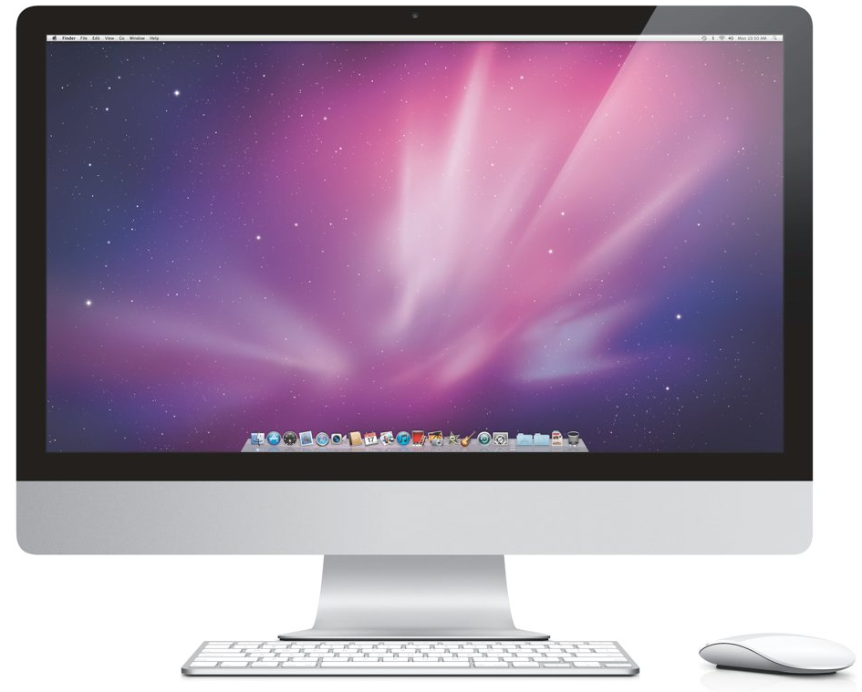
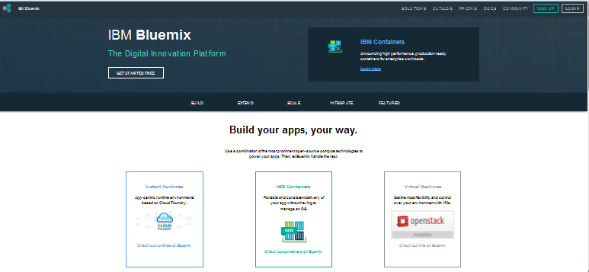
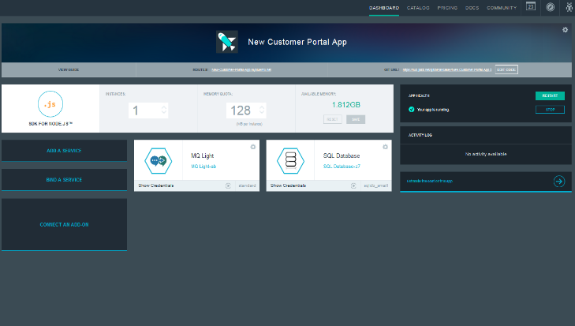
IBM Platform as a Service Offerings – Bluemix
Service catalog available on Bluemix
DevOps - From development to deployment
Big Data – Harness the power
Mobile – Quickly get started with your next app
Watson – Enable building cognitive apps
Business Analytics – Powerful analytics made easy
Data Management – Agile data mgmt. & refinement
Web and Application – Deliver new web & mobile apps
Security – Build security into application design
Internet of Things – A new generation of apps
Integration – Extend existing investments & Infrastructure
Developer experience
Rapidly deploy and scale applications in any language.
Compose applications quickly with useful APIs and services and avoid tedious backend config.
Realize fast time-to-value with simplicity, flexibility and clear documentation.
Enterprise capability
Securely integrate with existing on-prem data and systems.
Choose from flexible deployment models.
Manage the full application lifecycle with DevOps.
Develop and deploy on a platform built on a foundation of open technology.
Built on a foundation of open technology.
Notes:
Bluemix is IBM’s PaaS offering and atop of IBM SoftLayer to help you build, run, scale, manage, integrate & secure applications in the cloud.
It’s an open-standard, cloud-based platform for building, managing, and running applications of all types (web, mobile, big data, new smart devices, and so on). Bluemix brings a full suite of cloud services to one place, such as API management & Integration, DevOps, IoT, Cloud integration, Big Data and Analytics, Security and Watson to enhance development experience and provide enterprise capability.
So whether you’re creating apps for the web, for mobile, IoT or for Big Data, Bluemix can help you build them smarter and get them to market faster...
We will introduce detail Bluemix capabilities in later of this section.

Slide 10
Software as a Services (SaaS)
Software as a Service
Vendor Manages in Cloud
Benefits
Sign up and rapidly start using business applications.
Access apps and data from any connected end points
No data is lost if computer breaks
The service is able to dynamically scale to usage needs
No longer have to install, update and maintain the software
Code
Data
Runtime
Middleware
OS
Virtualization
Servers
Storage
Networking
Core IT
IaaS
PaaS
Time to initial deployment
~ Weeks
~ Days
~ Minutes
Notes:
SaaS is place where software providers share IT resources such as application software /services between customers to enable self-service, rapid elasticity, and pay-per-use pricing.

Slide 11
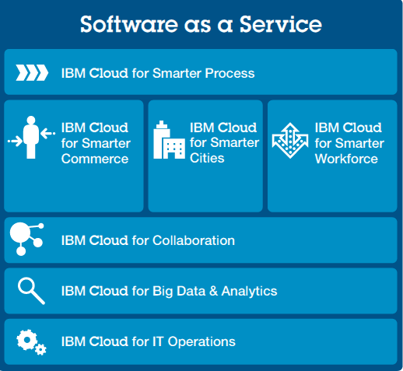
IBM Cloud SaaS Portfolio
Notes:
while most companies see the value of SaaS for specific needs, IBM delivers a broad portfolio of SaaS solutions around Big Data & Analytics, IT Operations, Business Process, Smarter Commerce, Smarter Cities, Smarter Workforce and social business, that can be deployed as part of a deeper business strategy to transform every aspect of an organization. With a robust cloud portfolio and proven track record in the industry, IBM is committed to delivering an innovative SaaS experience that combines the agility, compatibility and cost efficiency needed for every organization’s success now and into the future.
The IBM Cloud SaaS portfolio consists of five major categories with many unique applications, each designed to address unique business processes, industries and functions:
Business Process as a Service - Rely on BPaaS tools to manage specific industry solutions that streamline efficiencies, unify business processes and enhance customer experience.
IBM Cloud for Smarter Commerce - Leverage the power of the cloud to drive more meaningful interactions with customers and suppliers across every facet of the value chain: buy, market, sell and service.
IBM Cloud for Smarter Cities: Flexible, cost-effective SaaS solutions grow with a city’s demands and deliver the powerful data needed to efficiently manage resources and make informed, proactive decisions.
IBM Cloud for Social Business: Increase innovation and accelerate decision making by unifying human capital to build high-functioning communities.
IBM Cloud for Smarter Analytics: Facilitate better decisions, increased efficiency and faster innovation across the enterprise by delivering the right data to the right people more effectively and economically than ever.
With a robust cloud portfolio and proven track record in the industry, IBM is committed to delivering an innovative SaaS experience that combines the agility, compatibility and cost efficiency
needed for every organization’s success now and into the future.

Slide 12
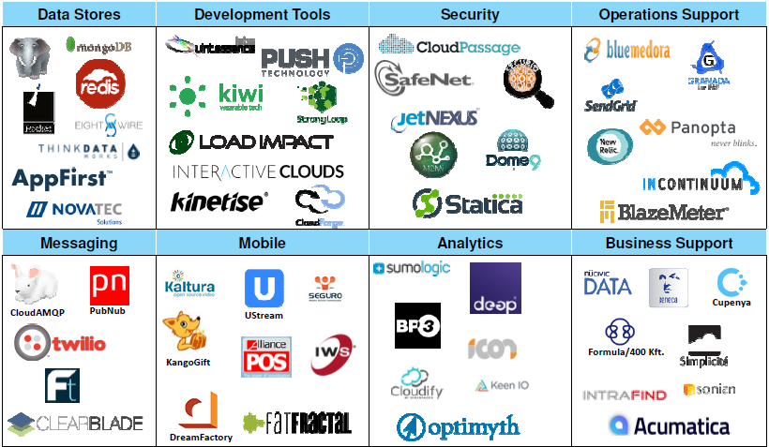
IBM Cloud Marketplace – Cloud Services Store
Is a dedicated area on ibm.com/cloud for IBM customers to discover enterprise cloud services that run on or are deployable on SoftLayer or integrated with Bluemix and are available from IBM & Business Partners. ibm.biz/newway4partners
Notes:
IBM Cloud marketplace is a customer facing cloud services store where the service providers (IBM or Business Partners) can publish their cloud services, and consumers (also called clients) can purchase these services.
IBM’s marketplace contains a variety of Software as a Service products that can be up and running within minutes of ordering. The services published on Market place are from both IBM and Business partners shown on the slide. More partners are publishing their applications as service on IBM Cloud Marketplace.
We have a limited preview of the IBM Cloud partner marketplace. You can Nominate your cloud offering now at ibm.biz/newway4partners.
We are working with partners who are creating API-based services which can be used by developers, such as location services and e-signature.
We are looking for cloud services that simplify, optimize and accelerate the cloud experience.
The IBM Cloud partner marketplace is available now in limited preview for partners who qualify - Nominate your cloud offering now at ibm.biz/newway4partners.
Details are in development, but the commercial model will likely follow established marketplace models.

Slide 13















Timing is Critical …so are all of your other investments
Leverage the power of Bluemix without abandoning what you already use.
Core IT
IaaS
PaaS
IBM Bluemix
Notes:
While timing is critical (what we just discussed), the systems and data you use today can’t be forgotten. That’s why Bluemix simply and securely connects to core IT and even other clouds (leveraging IBM’s proven reputation as a systems integrator).
Hybrid cloud, where Public and Private clouds work together with Core IT investments, is critical to success given the app revolution and the expectations and increased competition it has generated.
Overall, hybrid cloud represents the “New IT…”

Slide 14
Bookmarks & References
http://www.ibm.com/cloud-computing/us/en/
http://www.ibm.com/cloud-computing/us/en/iaas.html
http://www.ibm.com/cloud-computing/us/en/paas.html
http://www.ibm.com/cloud-computing/us/en/saas.html
http://www.ibm.com/developerworks/cloud/library/cl-open-architecture/
http://www.ibm.com/cloud-computing/us/en/open-cloud-essentials.html
https://www.bluemix.net
https://www.ng.bluemix.net/docs/#starters/index-gentopic4.html#genTopProcId5
https://www.ng.bluemix.net/docs/#starters/index-gentopic3.html#container_ov
https://www.docker.com/
https://www.clouddoundry.org/
Notes:
Here’s a list of useful bookmarks on the topics we covered in this section for your reference.

Slide 15
QUESTIONS?
https://ibm.biz/BdXGBL
Get help from Bluemix development team and Stack Overflow community
Notes:
Please post your questions or find the answers on Bluemix Community https://ibm.biz/BdXGBL

